Slide 1
Gaming & Academic Performance Analysis
Deep-Dive Analysis & Statistical Validation

Slide 2
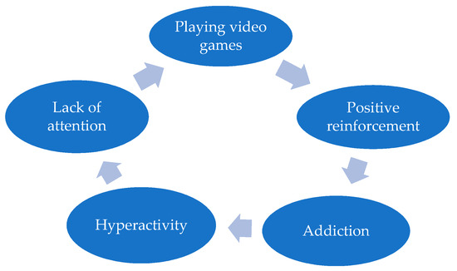
Problem Statement:
Students spend increasing time on gaming.
Academic performance may be affected.
Need data-driven insights.
Understand relationship between gaming and grades.

Slide 3
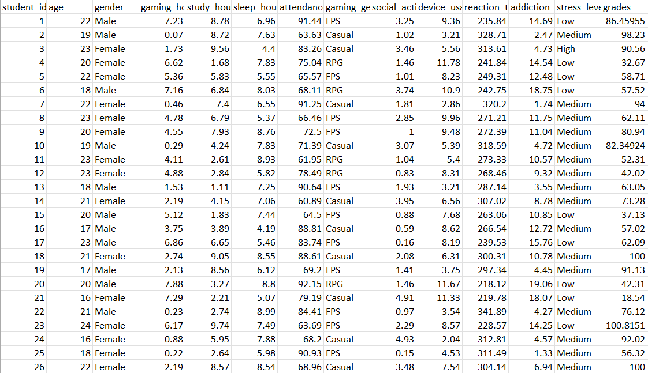
Dataset Information:
Feature | Description
Rows | Number of students
Columns | 14
Dataset Type | Student Gaming Behavior
Source | CSV Dataset
Important Features:
gaming_hours
study_hours
sleep_hours
grades
addiction_score
stress_level

Slide 4
DATA CLEANING & WRANGLING:
Removed duplicates
Checked missing values
Standardized column names
Verified data types
Prepared ready analysis dataset
Output of Cleaned Dataset:
 | student_id | age | gender | gaming_hours | study_hours | sleep_hours | attendance | gaming_genre | social_activity | device_usage | reaction_time_ms | addiction_score | stress_level | grades
0 | 1 | 22 | Male | 7.23 | 8.78 | 6.96 | 91.44 | FPS | 3.25 | 9.36 | 235.84 | 14.69 | Low | 86.459555
1 | 2 | 19 | Male | 0.07 | 8.72 | 7.63 | 63.63 | Casual | 1.02 | 3.21 | 328.71 | 2.47 | Medium | 98.230000
2 | 3 | 23 | Female | 1.73 | 9.56 | 4.40 | 83.26 | Casual | 3.46 | 5.56 | 313.61 | 4.73 | High | 90.560000
3 | 4 | 20 | Female | 6.62 | 1.68 | 7.83 | 75.04 | RPG | 1.46 | 11.78 | 241.84 | 14.54 | Low | 32.670000
4 | 5 | 22 | Female | 5.36 | 5.83 | 5.55 | 65.57 | FPS | 1.01 | 8.23 | 249.31 | 12.48 | Low | 58.710000

Slide 5
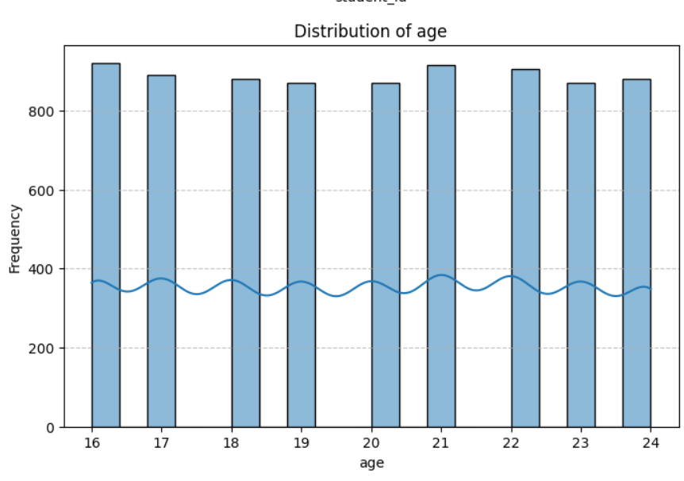
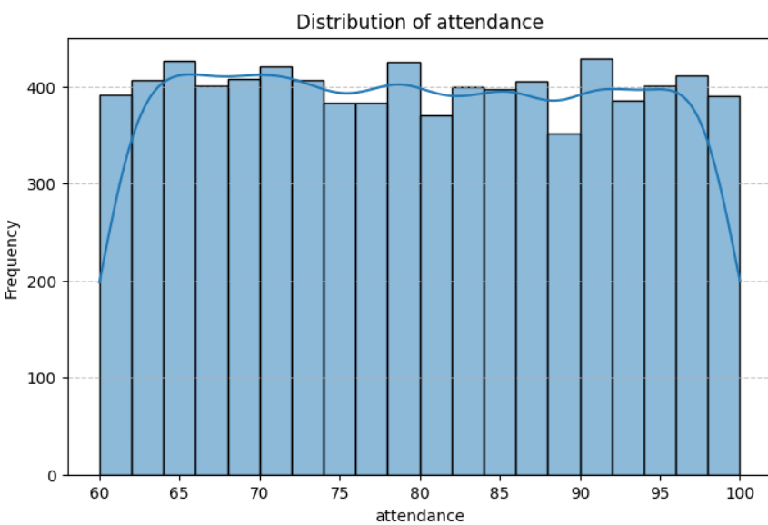
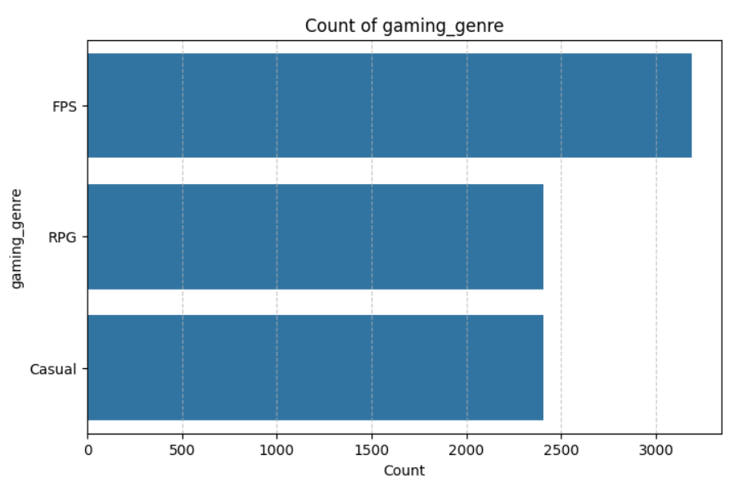
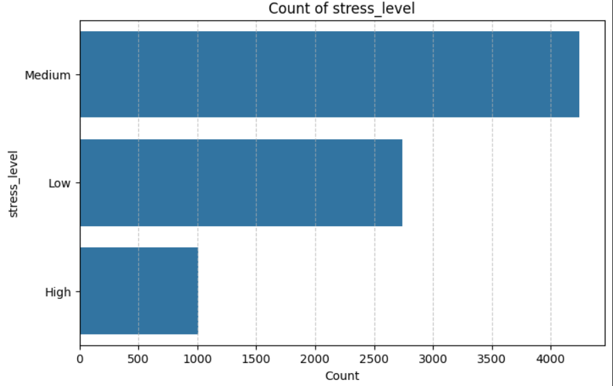
EXPLORATORY DATA ANALYSIS (EDA):

Slide 6
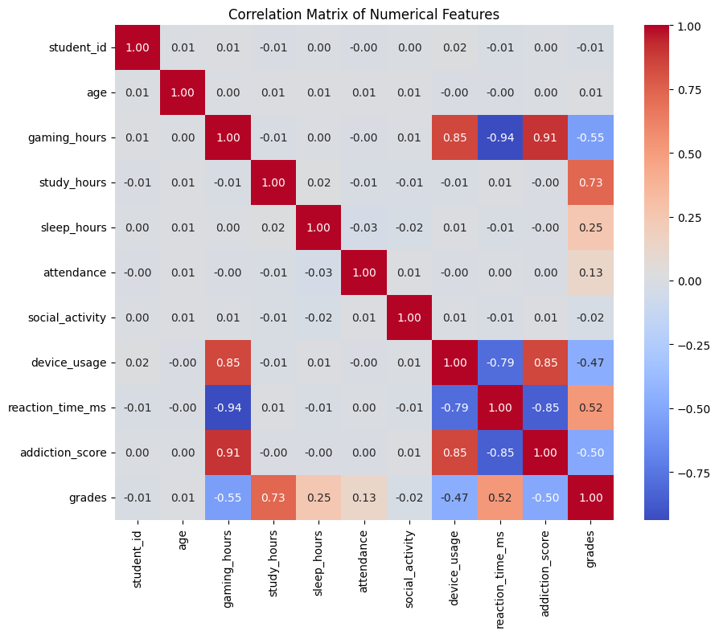
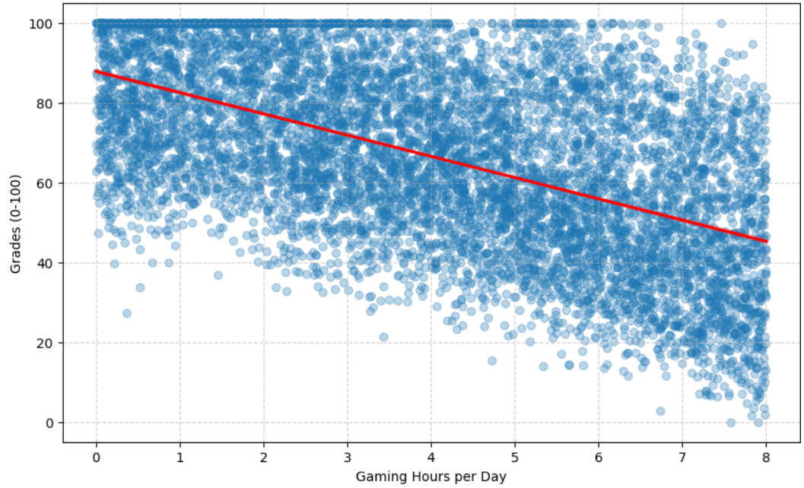
CORRELATION & RELATIONSHIPS:
Insights:
• Negative relation between gaming and grades • Sleep positively affects performance

Slide 7
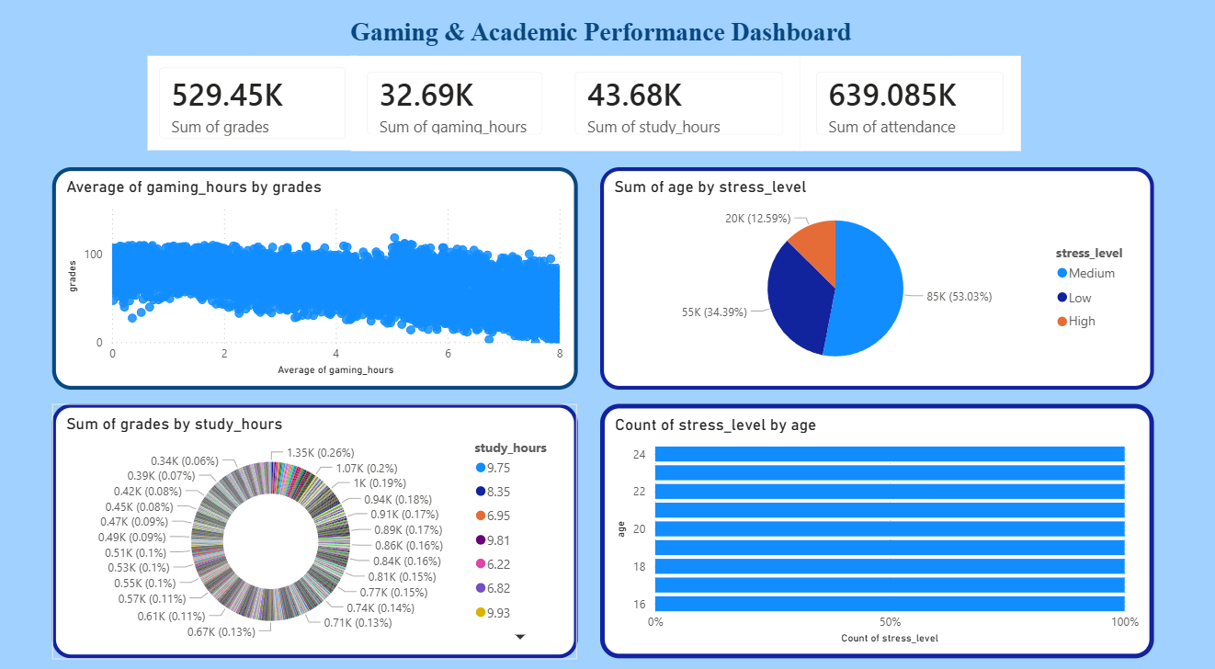
DASHBOARD OVERVIEW:

Slide 8
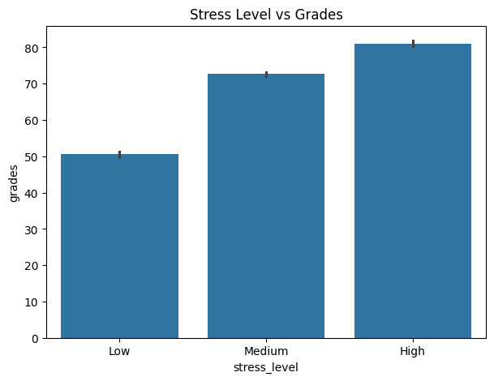
HYPOTHESIS TESTING:
Hypothesis
H₀
Gaming does not affect grades.
H₁
Gaming affects grades.
Cell Output:
Correlation value:-0.5513117134349623
-p value:0.0
Conclusion:
Reject Null Hypothesis.

Slide 9

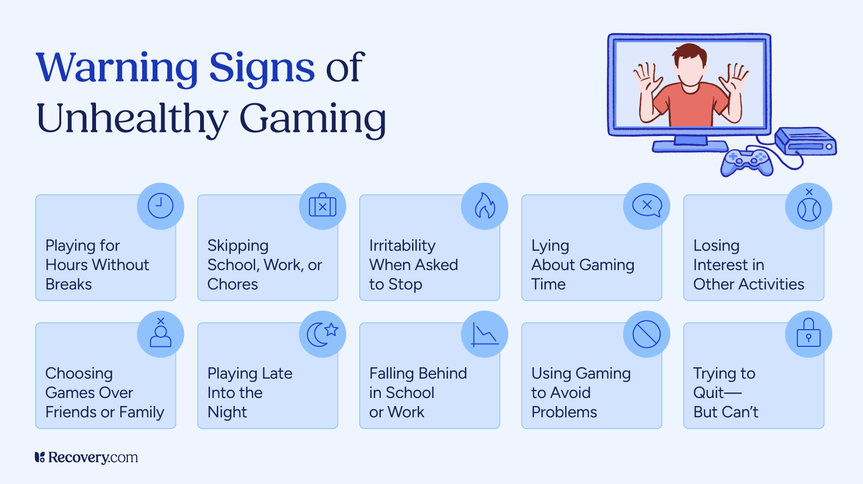
RECOMMENDATIONS:
Encourage balanced gaming
Promote time management
Student wellness programs
Monitor addiction patterns

Slide 10
Conclusion:
Gaming behavior affects academic performance.
Statistical analysis validated findings.
Dashboard provides actionable insights.
THANK YOU

